Slide 1

Course Name: Categorical Data Analysis using SAS
Course Duration: 15+ Hours Approx.
Course Resources: Materials + Data + Codes

Slide 2

Disclaimer
This course is designed to cover the Statistical Methods for categorical data analysis by using SAS software (like SAS/Stat, SAS/Graph, SAS/ODS, SAS/Base and SAS/Advance).
It assumes that candidate should have basic knowledge of descriptive statistics, confidence interval, hypothesis testing and linear regression.

Slide 3
Index/Agenda
Categorical Data Analysis
Examining Distributions
Test of Associations
Fisher's Exact p-values for Pearson Chi-square test
Logistic Regression
Odds and Odds Ratio
Simple Logistic Regression
Multiple Logistic Regression with categorical predictors
Analyze the output from Proc logistic

Slide 4
Index/Agenda
Measure Model Performance
Apply the principles of honest assessment to model performance measurement
Assess classifier performance using the confusion matrix
Model selection and validation using training and validation data
Create and interpret graphs (ROC, lift, and gains charts) for model comparison and selection
Establish effective decision cut-off values for scoring

Slide 5
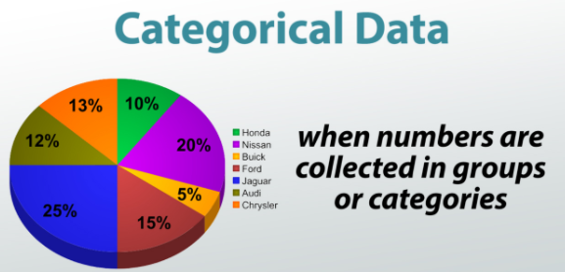
Examining Distributions

Slide 6
Examining Distributions
By examining the distributions of categorical variables, you can do following:
determine the frequencies of data values.
recognize possible association among the variables (Test of Association).
An association exists between two categorical variables if the distribution of one variable changes across the level/value of another variable.
If there is no association, the distribution of one variable is the same across the level of another variable.

Slide 7
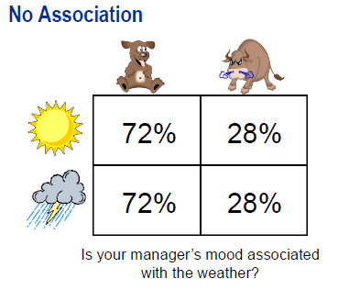
Examining Distributions
There appears to be no association between
manager’s mood and whether as each rows
has the same percentage in each column

Slide 8
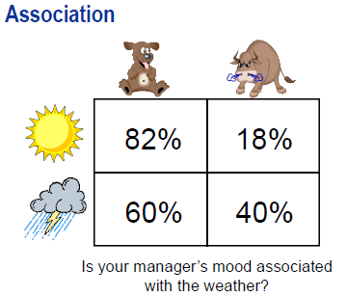
Examining Distributions
There appears to be an association between
manager’s mood and whether as each rows
has the different percentage in each column

Slide 9
Examining Distributions
Frequency Tables: A frequency table shows the number of observations across the level of categorical variable.
One-way frequency table analyze the one categorical variable. Two-way frequency table analyze two categorical variables and so on.
Frequency Table is the starting point for any of the categorical variable data analysis process.

Slide 10
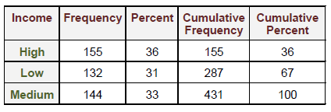
Examining Distributions
Frequency Table typically includes:
Frequency: is the number of times the value appears in dataset.
Percent: measures the proportion/percentage of the data that has this value.
Cumulative Frequency: accumulates the frequency values by adding the second frequency value to first frequency value and so on.
Cumulative Percent: accumulates the percent by adding the second value to first and so on.

Slide 11
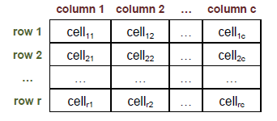
Examining Distributions
Crosstabulation Tables: A Crosstabulation table shows the number of observations for each combination of row and column variables.

Slide 12
Examining Distributions
Crosstabulation has four measures as follow:
Frequency: Number of observations falling into a category formed by row variable value and column variable value.
Percent: Number of observations in each cell as a percentage of total number of observations.
Row Pct: Number of observations in each cell as a percentage of total number of observations in that row.
Column Pct: Number of observations in each cell as a percentage of total number of observations in that column.

Slide 13
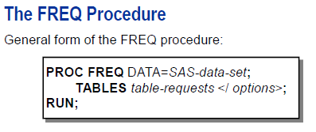
Examining Distributions
TABLES statement requests tables and options for producing the tests. The general form of a table request is variable1*variable2 …, where any number of these requests can be made in only one TABLE statement.
For a two categorical variable (Crosstabulation tables) the first variable represents the row variable and second variable represents the column variable.
PROC FREQ can generate large volume of output as the number
Categorical variable increases in TABLES statement.

Slide 14
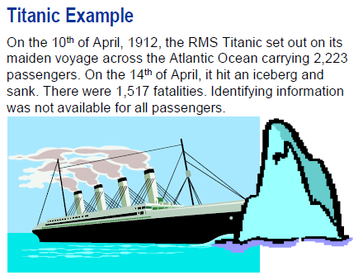
Examining Distributions
To analyze the Titanic dataset, we have following:
Survival: it shows survival status (1 = survived, 0 = died)
Age: absolute value of age of passengers in years.
Gender: Gender of passengers (male/female).
Class: ticket class (1,2,3)
Fare: ticket fare. (It is not so useful to analyze the Titanic dataset as it represents the ticket fare for a purchase for each person in a party.)
Titanic Dataset is available publically and it is the perfect fit for categorical data analytics

Slide 15

Examining Distributions
DEMO

Slide 16
Test of Associations
The obvious question is whether categorical variables are associated with each other
For Example: Is there any difference between gender and survived or to say differently, Is gender associated with Survived.
There are numerous amount statistical measures which gives you answer on associations and strength of associations between categorical variables.

Slide 17
Test of Associations
Perform a chi-square test for association.
Examine the strength of the association.
Calculate the exact p-values.
Perform a Mantel-Haenszel chi-square test for Ordinal Association.

Slide 18
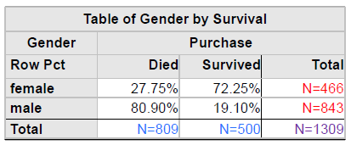
Test of Associations
There is an association between Gender and Survived variables as row percentages are different (72.25% vs. 19.10% and 27.75% vs 80.90%).
Test of association measures the “difference between probabilities of Male Surviving and female surviving is greater than would be expected by chance”

Slide 19
Test of Associations
Null Hypothesis:
There is no association between Gender and Survival.
The probability of surviving the Titanic crash was the same whether you were male or female.
Alternate Hypothesis:
There is an association between Gender and Survival.
The probability of surviving the Titanic crash was not the same for male or female.

Slide 20
Test of Associations
Chi-Square Test: The most popular measure to test for an association between two categorical variables is the “Pearson chi-square test.”
Chi-square test is based on observed cell frequencies and expected cell frequencies. It measures the difference between observed and expected cell frequencies.
Observed cell frequencies are calculated based on sample data. Expected cell frequencies are cell frequencies that are expected if there is no association between the variables.

Slide 21
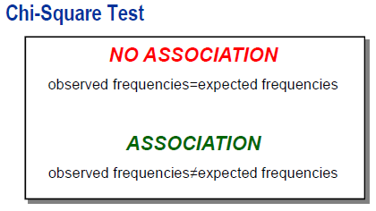

Test of Associations
If you have a significant chi-square
Statistics, there is strong evidence that an association exists between your variables.

Slide 22
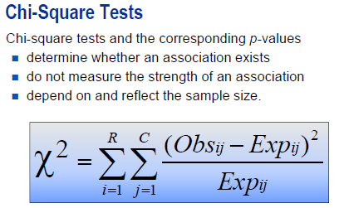
Test of Associations

Slide 23
Test of Associations
The p-value for the chi-square test only indicates how confident you can be that null hypothesis of no association is false. It does not tell you the magnitude of the association.
The value of chi-square statistics also does not tell you the magnitude of association. It can be prove that if you double your sample size, you double the value of chi-square statistic, even though the strength of the association does not change.

Slide 24
Test of Associations
The p-value for the chi-square test only indicates how confident you can be that null hypothesis of no association is false. It does not tell you the magnitude of the association.
The value of chi-square statistics also does not tell you the magnitude of association. It can be prove that if you double your sample size, you double the value of chi-square statistic, even though the strength of the association does not change.

Slide 25
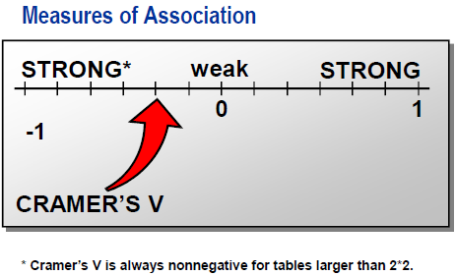
Test of Associations

Slide 26
Test of Associations
DEMO

Slide 27
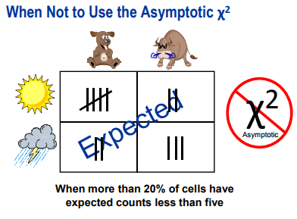

Fisher’s Exact p-value

Slide 28
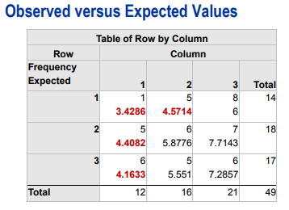
Fisher’s Exact p-value
The criteria to use the chi-square
algorithm is based on expected
frequencies. Here, 1 out of 9 or
11% of the cells has an observed
frequencies less than 5 and out
of or 44% of the cells have expected
frequencies less than 5. So in this case,
Chi-square test might not be useful.

Slide 29
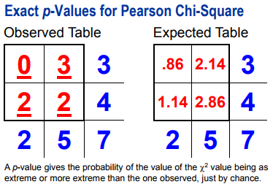
Fisher’s Exact p-value

Slide 30
Fisher’s Exact p-value
In previous left slide, with such a small sample size, the asymptotic p-values would not be valid because the accuracy of those p-values depends on large enough expected cell values in all the cells.
Exact p-values reflect the probability of observing a table with at least as much evidence of an association as the one actually observed, given there is no association among the variables.
Recall that expected count = (R*C)/T.

Slide 31
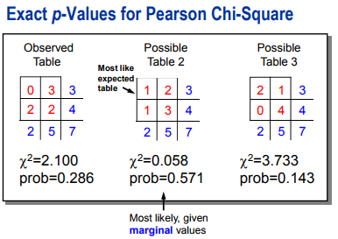
Fisher’s Exact p-value

Slide 32
Fisher’s Exact p-value
There are three possible tables, including observed table.
Row total and column are same across three tables because the computation of exact p-values is based on the assumption that row and column totals are same.
Possible Table 2 is the most like expected table. So, the probability (0.571) that its cell values would occur in a table, given these row and column totals and it is the greatest of any possible table that could occur by chance.

Slide 33
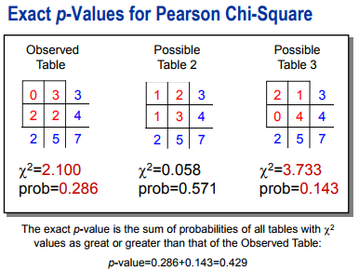
Fisher’s Exact p-value

Slide 34
Fisher’s Exact p-value
To compute the exact p-values for this example, examine the chi-square value for each table and the p-values for each tables.
Consider only p-values which are greater than observed table’s p-value.
So in this case, the exact p-value would be 0.286(observed table) + 0.143(Possible Table 3) = 0.429.
This means, you have 42.9% chance of obtaining a table with at least as much of an association as the observed table simply by random chance.

Slide 35
Fisher’s Exact p-value
DEMO

Slide 36
Test of Ordinal Association
Categorical variables can have ordinal level of measurement.
General Chi-Square test of association is not valid when the categorical variable is ordinal.
In our example, Survived and Class have general association (produced by proc freq). We can test whether Survived and Class have significant ordinal association.
The appropriate test for ordinal associations is the Mantel-Haenszel chi-square test.

Slide 37
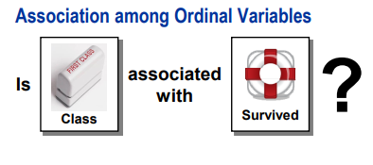
Test of Ordinal Association

Slide 38
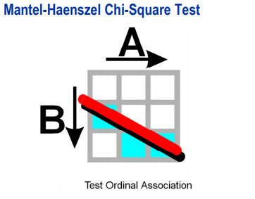
Test of Ordinal Association
The Mantel-Haenszel chi-square
test is sensitive to ordinal associations.
An ordinal associations implies that as one
variable increases, the other variable tends to increase, or decrease.

Slide 39
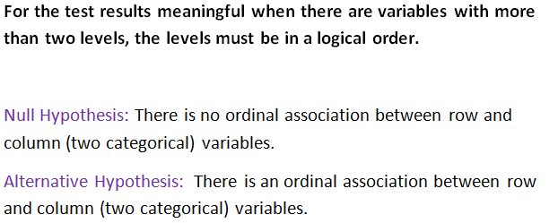
Test of Ordinal Association

Slide 40
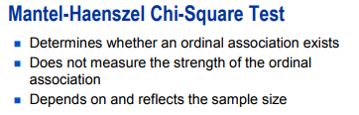
Test of Ordinal Association
The Mantel-Haenszel chi-square statistics is more powerful than general association chi- square statistics for detecting an ordinal association. The reason is that,
All Mantel-Haenszel statistics’ power is concentrated toward that objective.
The power of the general association statistics is dispersed over a great number of alternatives.

Slide 41
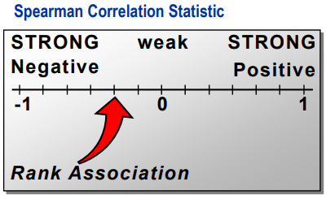
Test of Ordinal Association
To measure the strength of ordinal association, you can use the Spearman correlation statistic.
This statistic,
has a range between -1 to 1.
has a value close to 1 if there is relatively high degree of positive correlation.
has a value close to -1 if there is relatively high degree of negative correlation.
is appropriate only if both the variables are ordinal scaled and values are in logical order.

Slide 42

Test of Ordinal Association
The Spearmen statistic can be interpreted as the Pearson correlation between the ranks on variable X and ranks on variable Y.

Slide 43
Test of Ordinal Association
DEMO

Slide 44
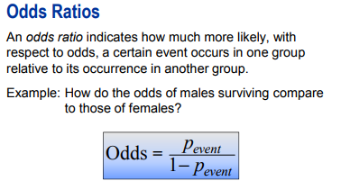
Odds and Odds Ratio
The odds ratio can be used as a measure of strength of association for 2*2 tables. Do not mistake odds for probability. Odds are calculated from probabilities.

Slide 45
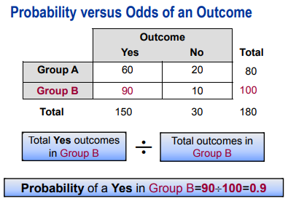
Odds and Odds Ratio

Slide 46
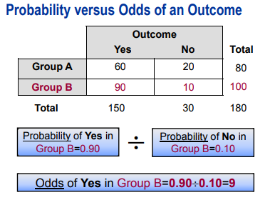
Odds and Odds Ratio

Slide 47
Odds and Odds Ratio
The odds of an outcome are the ratio of the expected probability that the outcome will occur to the expected probability that the outcome will not occur.
The odds for group B are 9, which indicate that you expect 9 times as many occurrences as non-occurrences in Group B.
What are the odds of having outcome in Group A?

Slide 48
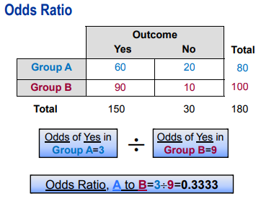
Odds and Odds Ratio

Slide 49
Odds and Odds Ratio
The odds ration shows the relationship between the predictor variable and outcome variable.
If the odds ratio is 1, then there is no association between predictor variable and outcome variable.
If the odds ratio is greater than 1, then Group A, the numerator group, is more likely to have the outcome.
If the odds ratio is less than 1, then Group B, the denominator group, is more likely to have the outcome.

Slide 50
Odds and Odds Ratio
DEMO

Slide 51
Logistic Regression
Concept of Logistic regression.
Fit a binary logistic regression model using the PROC LOGISTIC procedure.
Analyze the standard output from the LOGISTIC procedure with one continuous predictor variable.
Read and interpret odds ratio tables and plots.

Slide 52
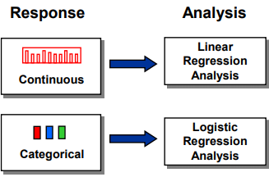
Logistic Regression

Slide 53
Logistic Regression
Regression Analysis enables you to characterize the relationship between a response variable and one or more predictor variable.
In Linear Regression, the response variable is numeric.
In Logistic regression, the response variable is categorical. It is useful to model responses like “Yes” or “No”, “Died” or “Survived” and so on.

Slide 54
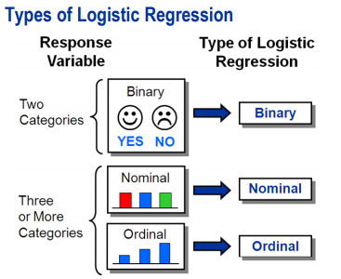
Logistic Regression

Slide 55
Logistic Regression
If the response variable is dichotomous (two categories), the appropriate logistic regression model is binary logistic regression.
For more than two categories (levels) within the response variable, then there are two possible logistic regression models:
1. If the response variable is nominal, you fit the nominal logistic regression model.
2. If the response variable is ordinal, you fit the ordinal logistic regression model.

Slide 56
Logistic Regression
You might be tempted to analyze a regression model with binary response variable using PROC REG. However, there is problem in that.
Besides the arbitrary nature of coding, there is the problem that predicted values will take on values that have no intrinsic meaning with regard to response variable.
There is also the mathematical inconvenience of not able to being assume the normality and constant variance when the response variable has only two values.

Slide 57
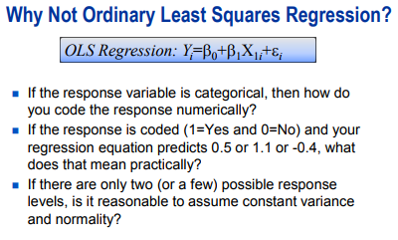
Logistic Regression

Slide 58
Logistic Regression
Instead of modeling the zeros and ones directly, another way of thinking about modeling a binary variable is to model the probability of either zeros and ones.
It can be done by using Linear Probability Model (LPM).
If you can model the probability of one (p), you can also model the probability of zeros (1-p).

Slide 59
Logistic Regression
One problem is that the predicted values from linear model can assume, theoretically, any values. However, probabilities are by definition bounded between 0 to 1.
Another problem is that the relationship between probability of outcome and predictor variable is nonlinear rather than linear.
Probabilities do not have random normal error associated with them, but rather a binomial error of p*(1-p).

Slide 60
Logistic Regression
Finally, there is no such thing as an “observed probability” and therefore least methods cannot be used.
The response variable is always either 0 or 1 and therefore the probability of event is either 0% or 100%.
Because of above reason, why it is untenable to assume a normal distribution of error.

Slide 61
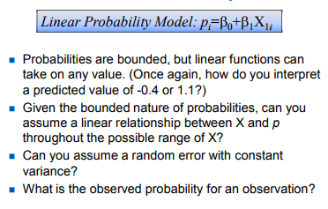
Logistic Regression

Slide 62
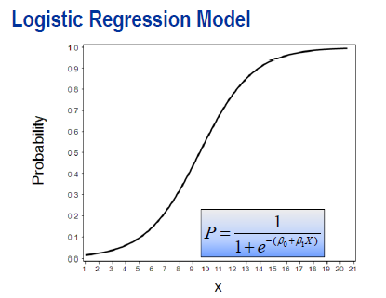
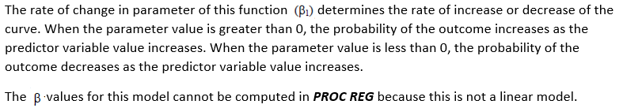
Logistic Regression
This plot shows a model of relationship between a continuous predictor and probability of an event or outcome. The linear model clearly does not fit if this is the true relationship between X and probability.
In order to model this relationship directly, you must use the nonlinear function. One such function is displayed. The S-shape of the function is known as sigmoid.

Slide 63
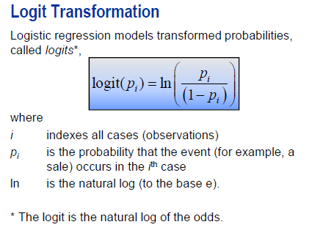
Logistic Regression

Slide 64
Logistic Regression
A logistic regression model applies a logit transformation to the probabilities. Two of the problems that we saw with modeling the probability directly were that probabilities were bounded between 0 and 1, and that there was not likely a straight line relationship between predictors and probabilities.
First deal with the restricted range of probability. What about a range of a logit? As p approaches its minimum value of 0, p / (1-p) approaches 0. The natural log of something approaching 0 is something that goes to negative infinity. So, the logit has no upper or lower bounds.
If you can model the logit, then simple algebra enables you to model the odds or probability. The logit transformation ensures that the model generates the estimated probabilities between 0 and 1.

Slide 65
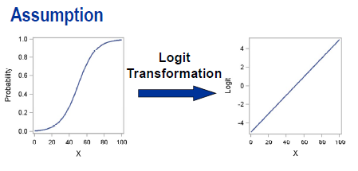
Logistic Regression
Assumption in logistic regression: The logit has a linear relationship with the predictor variables.
If the hypothesized nature of direct relationship between X and p are correct, then the logit has a linear relationship with X through the parameters. In other words, a linear function of X, additive in relation to the parameters, can be used to model the logit. In that way, you can indirectly model the probability.
To verify this assumption, it would be useful to plot the logits by the predictor variable.

Slide 66
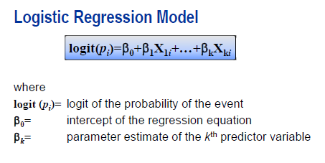
Logistic Regression
For a binary response variable, the linear logistic model with one predictor variable has the form above.
Unlike linear regression, the logit is not normally distributed and variance is not constant. Therefore, logistic regression requires a more computationally complex estimation method, names the Method of Maximum Likelihood, to estimate the parameters. This is accomplished by maximizing the likelihood function that expresses the probability of the observed data as a function of unknown parameters.

Slide 67
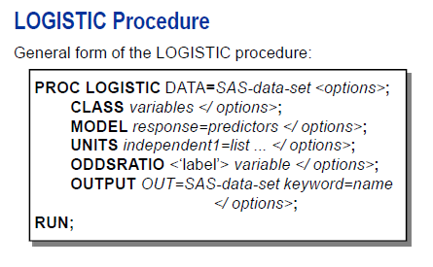
Logistic Regression

Slide 68
Logistic Regression
Selected LOGISTIC procedure statements:
CLASS names the classification variables to be used in the analysis. The CLASS
Statement must precede the MODEL statement. By default, these variables
Will be analyzed using effect coding parameterization. This can be changed
With the PARM= option.
MODEL specifies the response variable and predictor variables.
OUTPUT creates an output dataset containing all the variables from the input dataset
And any requested statistics.
UNITS enables you to obtain the odds ratio estimate for a specified change in a
Predictor variable. The units of change can be number, standard deviation
(SD), or a number times the standard deviation (for example, 2*SD).
ODDSRATIO produces the odds ratio for variables even when the variables are involved in
Interactions with other covariates, and for classification variables that use
Any parameterization. You can specify several ODDSRATIO statements.

Slide 69
Logistic Regression
DEMO

Slide 70
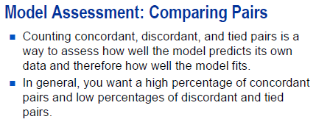
Logistic Regression

Slide 71
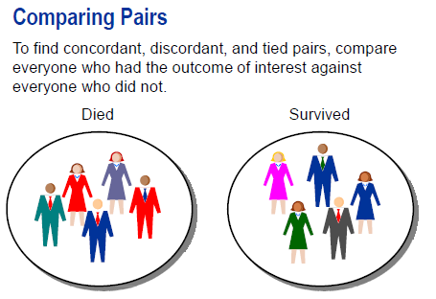
Logistic Regression

Slide 72
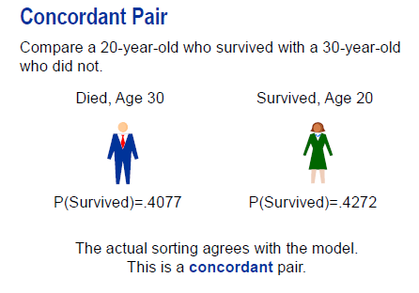
Logistic Regression
For all pairs of observations with different values of the response variable, a pair is concordant if the observation with the outcome has a higher predicted outcome probability (based on the model) than the observation without the outcome.

Slide 73
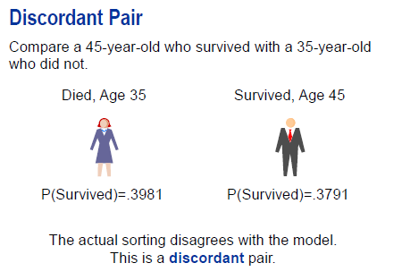
Logistic Regression

Slide 74
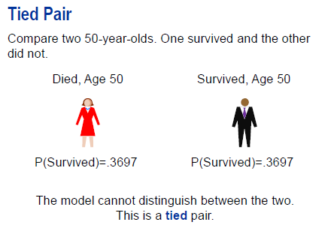
Logistic Regression
A pair is tied if it is neither concordant nor discordant. (The probabilities are the same.)

Slide 75
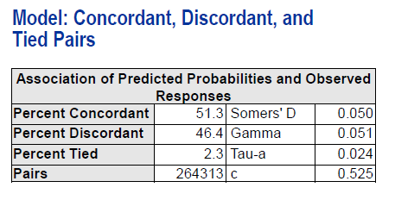
Logistic Regression

Slide 76
Logistic Regression
The Association of Predicted Probabilities and Observed Responses table lists several measures of association to help you assess the predictive ability of the logistic model.
The number of pairs used to calculate the values of this table is equal to the product of the counts of observations with positive responses and negative responses. In this example, that value is 427*619 = 264,313.
You can use these percentages as goodness-of-fit measures to compare one model to another. In general, higher percentages of concordant pairs and lower percentages of discordant pairs indicate a more desirable model.

Slide 77
Logistic Regression
The four rank correlation indices (Somer’s D, Gamma, Tau-a, and c) are computed from the numbers of concordant, discordant and tied of pairs of observations. In general, a model with higher values of these indices has a better predictive ability than a model with lower values for these indices.
The c (concordance) statistic estimates the probability of an observation with the outcome having higher predicted probability than an observation without the outcome. It is calculated as the percent concordant plus one half the percent tied. The range of possible value is 0.500 (no better predictive power than flipping a fair coin) to 1.00 (perfect prediction).
Here, the value of 0.525 shows a very weak ability of age to discriminate between those who survived and those who did not.

Slide 78
Logistic Regression
State how a logistic model with categorical predictors does and does not from the one continuous predictors.
Describe the functionality of CLASS statement.
Define the standard output from LOGISTIC procedure with categorical predictor variables.

Slide 79
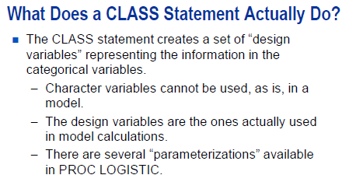
Logistic Regression

Slide 80
Logistic Regression
The CLASS statement creates a set of “design (dummy) variables” representing the information contained in any categorical variables. These design variables are incorporated into the MODEL calculations rather than the original categorical variables. Character variables cannot use a variable with values like “yes” or “no” adequately in the determination of the model.
Even if categorical variables are represented by numbers like 1, 2, 3, the CLASS statement tells SAS to set up design variables to represent the categories. This is necessary because the numeric values that are assigned to the levels of the categorical variables are generally arbitrary and might not truly reflect distances between levels.

Slide 81
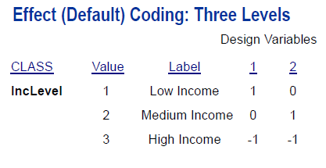
Logistic Regression
For effect coding (also called deviation from the mean coding), the number of design variables created is the number of levels of CLASS variable minus 1. For example, IncLevel has three levels, two design variables were created. For the last level of CLASS variable (High Income), all the design variables have a value of -1.
Parameter estimates of the CLASS main effects using this coding scheme estimate the difference between the effect of each level and the average effect over all levels.

Slide 82
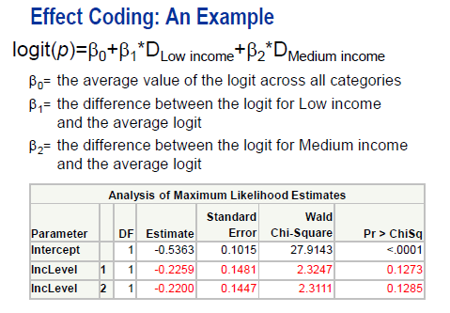
Logistic Regression

Slide 83
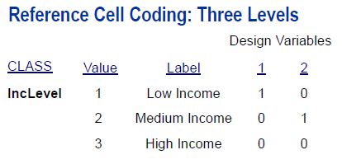

Logistic Regression

Slide 84
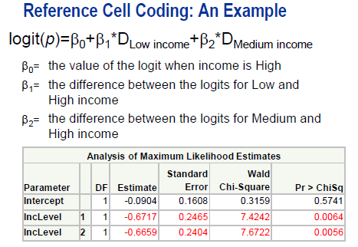
Logistic Regression

Slide 85
Logistic Regression
Notice the difference between this table and previous parameter estimates table. Because you used the Reference Cell Coding, instead of the Effect Coding, the meaning of the parameter estimates and p-values are different.
Now, the parameter estimate and p-value for IncLevel = 1 reflect the difference between IncLevel = 1 and IncLevel = 3 (the reference level).
It is important to know what type of parameterization you are using in order to interpret and report the results of this table

Slide 86
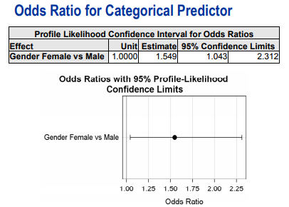
Logistic Regression
Odds Ratios for categorical predictors are reported for bi-group comparisons in PROC LOGISTIC, no matter which parameterization is chosen. Thus, even if Effect Coding is selected for Gender variable, the odds ratio tables display odds comparison between female and male (and not females versus the average of both).

Slide 87
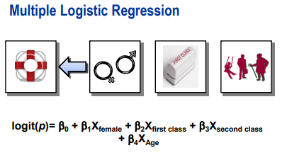
Logistic Regression
Each design variable is assigned its own beta value. The number of parameters in the logistic model takes into account the intercept, the number of continuous predictors, and the number of design variables assigned to CLASS variables.
So in this example, we include the following design variables
Gender – Female
Class – First Class
Class – Second Class
and continuous predictor variable Age.

Slide 88
Logistic Regression
DEMO

Slide 89
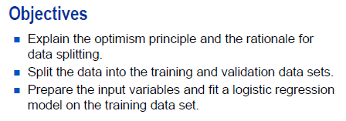
Honest Assessment

Slide 90
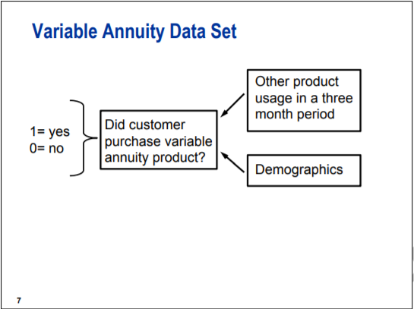
Honest Assessment
A target marketing campaign for a bank was undertaken to identify segments of customers who are likely to respond to a variable annuity (insurance product) marketing campaign.
The binary target variable Ins, indicates whether the customer bought the variable annuity product or not. The 47 input variable represents the other product usage in last three months period and demographics. Two of the inputs are nominally scaled; the others are interval or binary.

Slide 91

Honest Assessment
Evaluating the performance of classifier on same data used to train the classifier usually leads to an optimistically biased assessment.
Here, the classifier was fit (more properly overfit) to a 10-case data set. It correctly classified 70% of the cases. However, when the same classification rule was applied to the 100 new cases from the same distribution, only 47% were correctly classified. This is called the “overfitting”.

Slide 92
Honest Assessment
The simplest strategy for correcting the optimism bias is to hold out a portion of the development for assessment. The model is fit to the reminder (training data set) and performance is evaluated on the holdout portion (validation data set). Usually, from one-fourth to one-half of the development data is used as a validation data set.
When the holdout data (validation set) are used for comparing, selecting and tuning models and chosen model is assessed on the same data set that was used for comparison, then the optimism principal again applies.
To overcome this situation, another holdout portion is needed for final assessment. This holdout portion is called the “test data set”.
To conclude, if model tuning and final assessment are both needed, then the data should be split in three ways into “training”, “validation” and “test” sets.
In some situation, the test set is gathered from a different time or location.

Slide 93

Honest Assessment

Slide 94
Honest Assessment
Split the data into training and validation sets. Redo the input preparation and the model fitting on the training data set.
The validation data will be used for assessment. Consequently, it needs to be treated as if it were truly new data where target variable value is unknown.
The result of the analysis on the training data set need to be applied to the validation data, not recalculated.
Several input-preparation steps can be done before the data are split. Creating missing indicator variables should be done on full data because result will not be change.

Slide 95


Rare Event
In joint sampling, the input-target pairs are randomly selected from their joint distribution.
In separate sampling, the inputs are randomly selected from their distributions within each target class. Separate sampling is standard practice when the target event is rare. It is common to oversample the rare event, that is, take a disproportionately large number of rare event cases.

Slide 96


Rare Event
The maximum likelihood estimates are derived under the assumption that Y have independent binomial distribution. This assumption is appropriate for joint sampling but not for the separate sampling. However, the effects of violating this assumption can be easily corrected. In standard logistic regression model, only parameter estimate of intercept (B0) would be impacted.
The appropriate adjustment of oversampling is to add the offset variable in the model as follow:

Slide 97


Rare Event
We can directly fit the model discussed in previous slide. Alternatively, the offset can be applied after the standard model is fitted by using following formula.

Slide 98
DEMO

Slide 99
Confusion Matrix
Supervised classification does not usually end with estimate of the probabilities. An allocation rule corresponds to a threshold value (cutoff) of the predicted probability. For example, all the cases with probabilities of purchasing insurance product greater than 0.4 are potential customers and company will target only those customers while sending discount/promotional offers.
Here, the question is how well does the classifier/threshold/cutoff perform?

Slide 100

Confusion Matrix
The fundamental assessment tool is confusion matrix. The confusion matrix is a crosstabulation of actual and predicted classes. It quantifies confusion of classifier. The event of interest whether it is unfavorable (like fraud, churn or default) or favorable (like response to offer) is often called positive. The simplest performance statistics are
Accuracy = (true positives + true negatives) / total cases
Error or misclassification rate = (false positive + false negative) / total cases

Slide 101


Confusion Matrix
Two specialized measures of classifier performance are:
Sensitivity = true positives / total actual positives
Positive predicted value (PV+) = true positives / total predicted positives
The analogs to these measures are:
Specificity = true negatives / total actual negatives
Negative predicted value (PV-) = true negatives / total predicted negatives

Slide 102

ROC Curve

Slide 103
ROC Curve
The receiver operating characteristics (ROC) curve was adopted from signal detection theory for the assessment of classifiers/cutoff. The ROC curve displays the sensitivity and specificity for the entire range of cutoff values.
As the cutoff decreases, more and more cases are allocated to class 1. Hence, the sensitivity increases and specificity decreases. As the cutoff increases, more and more cases are allocated to class 0. Hence, the sensitivity decreases and specificity increases.
The ROC curve intersects (0,0) and (1,1). If the probabilities are arbitrarily assigned to the cases, then the ratio of false positives to true positives would be equal to the ratio total actual negatives to the total actual positives. In this case, baseline (random) model is a 45-degree angel going through the origin.
As the ROC curve bows above the diagonal line, the predictive power increases. A perfect model would reach the (0,1) where sensitivity and specificity are equal to 1.

Slide 104

Lift/Gains Chart

Slide 105
Lift/Gains Chart
Lift chart displays the lift and depth for a range of cutoff values.
A depth is the total proportion of cases that were allocated to class 1.
A lift is PV+/p1, so for a given depth, there are lift times more responders targeted by the model than by random chance.
As the cutoff decreases, more and more cases are allocated to class 1 and hence, the depth increases and PV+ approaches the marginal (additional) event rate. When cutoff is minimum, then 100% of the cases are selected and response rate is p1.
A model with good predictive power, would have increasing lift as the depth is minimum.
If the probabilities are arbitrarily assigned to the cases, then the lift/gains chart would be horizontal line at p1.

Slide 106
DEMO

Slide 107

Allocation Rule

Slide 108


Allocation Rule

Slide 109

Allocation Rule
A formal approach to determining optimum cutoff uses statistical decision theory. The decision-theoretic approach starts by assigning profit margins to true positives and loss margins to false margins. The optimum decision rule or cutoff would maximize the total expected profit.
The profit matrix shown here is consistent with a marketing effort that costs $1, and when successful, the revenue is $100. Hence, the profit for soliciting a non-responder is -$1 and the profit for soliciting a responder is $100 - $1 = $99.

Slide 110


Allocation Rule
The Bayes Rule is the decision rule that maximizes the expected profit.
Using the profit matrix defined earlier, the optimum cutoff becomes
Note: The Bayes Rule might not achieve the maximum profit if the estimate of the posterior probability is poorly estimated.

Slide 111
DEMO

